Slide 1
How to Create Your Own Internship
Sumayya Essack
Career Development Office
Notes:
Mention background in hr

Slide 2
Overview
Understand
Know yourself and your goals
Connect
Take an informational approach
Propose
Take the lead on proposing the project

Slide 3
Guideline 1: Know Your Goals
Yourself
Companies
What Your Can Contribute
Your goals/motivations/ interests/skills
What kind of internship supports your long-term goals
Target list of companies
Choose a functional area
Preliminary brainstorming of how you could add value

Slide 4
Guideline 2: Connect With an Informational Approach
Get Introduced
Get introduced/make the connection
Warm introductions are preferred if possible
Resources: LinkedIn alumni group, SIA, Advisors Hub, faculty, peers, etc
Ask if they’re open to discussing a project
Typically not done in the first meeting
Read the situation
You’ll likely have many informational conversations, and not all will lend themselves to this approach

Slide 5
Guideline 2: Connect With an Informational Approach
Get Introduced
Research
2. Before the conversation: Research
→ Prepare perspectives/ideas on the company and industry
Resources: Pitchbook, Plunkett, Crunchbase, etc.

Slide 6
Guideline 2: Connect With an Informational Approach
Get Introduced
Research
Understand &
Demonstrate
3. Understand and demonstrate
Ask questions to understand their challenges and priorities
Demonstrate your insights and value

Slide 7
Guideline 3: Take the Lead on a Proposal
Take the Initiative & be Entrepreneurial
What can you do for them?
Take the burden off of them
Shape a 1-page proposal, then collaborate with them to adjust (Project definition, timeline, outcomes, deliverables, compensation (Internship employment report → hourly rate)

Slide 8
Example Email
(real email, names changed)

Slide 9
Dear Dr. Murphy,
I have become very interested in what you do at ABC cell therapy after having conversations with your colleague Amir Kahney. It is a very innovative field with a unique, differentiated, high-quality product that I believe has enormous potential.
I am currently an MBA student at MIT Sloan and my summer internship search is in full swing. I would be very interested if there are any projects you might need some support with this summer.
My skills include:
Understanding brand fit and brand equity as well as the strategic benefits of having a strong alignment of the values of customers and the business, which in turns increases customer reach and awareness
Market analysis, and market forecasting to aid the development and release of new products to identify ideal customer demographic
Developing creative solutions and quality presentations to advocate for new expansion ideas based on market trends while identifying missing customer needs
I would be thrilled to meet and chat with you to discuss your division, industry, and the potential of working together this summer. You have been very successful at ABC firm developing strategies over the years, and I would welcome the chance to ask a few questions about implementation.
Please feel free to contact me via email or through my mobile phone 555-555-5555.
Sincerely,
Alice Waters

Slide 10
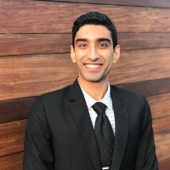
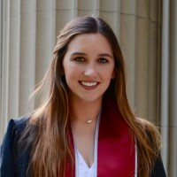
Examples
Air Asia
CEO spoke on campus at a club event, spoke with CEO afterwards
Over 2 months, kept in touch with CEO and Chief of Staff
Unstructured internship, owned at least 1 project
Contack
Leaned on Sloan/peer network
Friend of friend knew a DeltaV founder looking for a Product Manager
Thought about the responsibilities, what she wanted, what they needed
Ishan Shah
Elizabeth Blackburn
Notes:
Ishan received an offer to intern with Air Asia. He initially recruited for internships with MBB, but was not successful (but was encouraged by the firms to reapply for FT). The CEO of Air Asia was on campus speaking at a club event in early February. Ishan spoke to the CEO after the event and he was told to keep in touch. Over the course of two months he followed up with the CEO and Chief of Staff. His internship was very unstructured - shadowing the CEO and Chief of Staff, with ownership of at least one project over the summer. He was based in Malaysia for the summer. He re-recruited for Consulting full-time and landed an offer with BCG in Atlanta (he kept the airlines as a theme/rationale for choosing the Atlanta office).

Slide 11
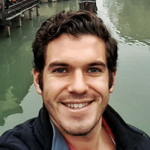
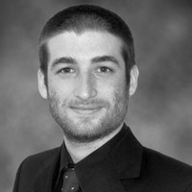
Examples
Global CoCreation Lab
Found them in the fall semester
“Kept showing up and asking questions”
Made an outcome-based proposal
Kayak
Contacted VP of Talent in February with a proposal for several projects
She passed it to the interim Head of Product
At a meeting, the CTO joined and made an offer on the spot
Steve DeSandis
Gabriel Szuchmacher
Notes:
Gabriel did his internship with Kayak. He reached out to the VP of Talent in February with a proposal for several projects and she passed his proposal along to the interim Head of Product. He met with them and the Head of Product ended up pulling the Chief Technology Officer into the meeting, who then extended an offer to him on the spot. He was an international student and Kayak typically did not sponsor, but the combination of his pre-MBA experience with airlines in Latin America and the quality of his presentation (it was a powerpoint deck outlining ways Kaya could address the LatAm market) won them

Slide 12
Additional Points
→ Pursue multiple opportunities
→ Know yourself and if this approach is right for you
→ Chat with a Career Advisor

Slide 13
Good luck!

